Slide 1
Distracted Driving
A research driven intervention
Dr. Kate O’Donnell, AAA Research Manager
Mr Tim McLaren, AAA Campaign Director
MAY 2020
Partners
Sponsor

Slide 2
Premise
The iPhone generation
Complex connectivity
Habits formed early

Slide 3
Premise
Addiction may be a factor.
If it is… can we use established management techniques?

Slide 4
Overview
1. Addiction?
Establishing a link between addiction and smart phone use while driving, and identifying strategies to underpin resources.
2. Risk?
Quantifying the impact of smart phone use on driving, and comparing to other risky driving behaviours.
3. Comparison
Develop a research tool methodology to internationally track smartphone use, attitudes and driving behaviours
4. Evaluation
Test the effectiveness of the resources for managing phone use while driving.

Slide 5
Relative Risk
COMPARING WITH OTHER KNOWN RISKY BEHAVIOURS
What is the research goal?
To understand how phone use while driving compares with other known risky driving behaviours
For young novice drivers
For older more experienced drivers
Why research this?
Risk from distracted driving is understood.
However, the relative contribution of risky behaviours to crashes & road trauma is unknown
How did we conduct the research ?
Asked experts (local and international) + analysed responses to derive risk index
32 International road safety experts
13 Different countries
Australia, Belgium, Canada, Ghana, India, Iran, Lithuania, New Zealand, Portugal, Spain, Switzerland, UK, USA

Slide 6
Research project #1
Risk and Prevalence
DISTRACTED DRIVING
OTHER BEHAVIORS
Looking away from the road at your phone for more than 2 seconds
Driving while tired
Using a music app
Speeding (by more than 10km/h)
Talking on the phone (hands-free or handheld)
Drink driving (3 standard drinks)
Using GPS/maps
Driving after smoking marijuana

Slide 7
Research project #1
Risk and Prevalence
RELATIVE RISK SCALE
VERY HIGH
EXPERIENCED DRIVERS

Slide 8
Research project #1
Risk and Prevalence
RELATIVE RISK SCALE
VERY HIGH
YOUNG DRIVERS

Slide 9
Research project #1
Risk and Prevalence
INCREASE RISK OF CRASH
0x
1x
2x
3x
4x
5x
YOUNG DRIVERS

Slide 10
Research project #1
Risk and Prevalence
INCREASE RISK OF CRASH
0x
1x
2x
3x
4x
5x
EXPERIENCED DRIVERS

Slide 11
Prevalence and Influences
PHONE USE WHILE DRIVING
What is the research goal?
To understand use (when, how, what) The prevalence (frequency) and the influences
Why research this?
Build an evidence-based toolkit of resources aimed at young drivers (Australia and NZ)
How did we conduct the research ?
10 Focus groups = Explored issues in depth and drove design of surveys
2 x surveys – 1 week apart
2 x driving scenarios (moving & stop/start traffic)
3 x types phone use (calling/texting/messaging - social media – entertainment /relaxation apps)

Slide 12
Prevalence and Influences
PHONE USE WHILE DRIVING
4 population groups
7 separate data sets
Young drivers
17 – 25 years
(n=237)
Young drivers
17 – 25 years
(n=189)
Older drivers
26 + years
(n=517)
Australia (n = 754)
Older drivers
26 + years
(n=346)
New Zealand (n = 535)

Slide 13
Theory, structure and analysis
RESEARCH METHODS
THEORETICAL & ANALYTICAL BASE
Theory of Planned Behaviour
Mobile Phone Problematic Use Scale
Behaviour of Young Novice Drivers
Cognitive Capture
STRUCTURE OF SURVEY
Demographics and characteristics of participants
Usage – whether legal or illegal
Theory of Planned Behaviour (to understand motivations)
Cognitive Capture
Mobile Phone Problematic Use Scale (testing “addiction” in normal life)
Behaviour of Young Novice Drivers Scale (testing risk taking on road)
Strategies used and found successful
ANALYSIS
Frequency distributions
Regression analyses
Multi-variate analyses
Thematic analyses

Slide 14
How are young drivers using their phone
46%
46%
31%
42%
Looked at phone while in the hand
Looked at phone while in the cradle
Used voice commands
Vehicle controls (steering wheel)

Slide 15
How are young drivers using their phone?
SMART PHONE APPLICATIONS
While Moving
Stop/Start
TEXTING ONLY APPS
12.1%
31.2%
PICTURE OR CONTENT SHARING SOCIAL MEDIA
4.6%
12.1%
MUSIC APPS
64.7%
75.1%
VIDEO STREAMING
2.9%
3.5%
DRIVING APPS
33.5%
38.2%

Slide 16
How are young drivers using their phone?
SMART PHONE FUNCTIONS
While Moving
Stop/Start
CREATED A SOCIAL MEDIA POST
1.1%
2.3%
SCROLLED THROUGH A SOCIAL NEWSFEED
2.3%
4.6%
PARTICIPATED IN A CHAT
10.3%
24.1%
PARTICIPATED IN A CHAT VIA VIDEO
2.9%
2.9%
WATCHED VIDEOS
1.1%
4.0%
USED A PHOTO MESSAGING APP
7.5%
19.5%

Slide 17
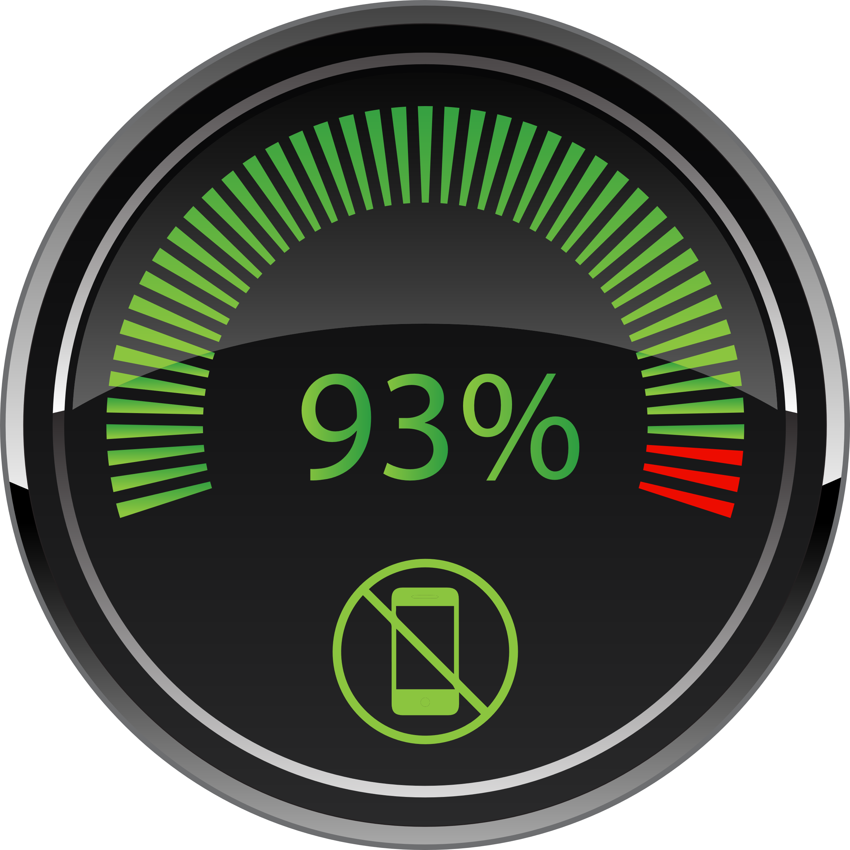
Young drivers are trying to reduce their using their phone use
Only 7% of young people indicated they have never tried one of the management strategies suggested by the survey.

Slide 18
What are their strategies to reduce use?
Effective strategies

Slide 19
What are their strategies to reduce use?
Effective strategies vs Used strategies

Slide 20
Why are young drivers using their phone?
- What we assessed
Intention to use
On road risk taker
Believe they are in control
Don’t believe it is wrong
See benefit in using
Approval of others
See friends using
Not recognising risk
Gender
See parents using
Smartphone problem use
Age

Slide 21
Why are young drivers using their phone?
- Statistically significant + biggest impact
Intention to use
On road risk taker
Believe they are in control
Don’t believe it is wrong
See benefit in using
Approval of others
See friends using
Not recognising risk
Gender
See parents using
Smartphone problem use
Age

Slide 22
Why are young drivers
USING ENTERTAINMENT APPS
Intention to use
See benefit in using
See friends using
Don’t believe it is wrong

Slide 23
Why are young drivers
CALLING/TEXTING
Intention to use
See parents using
See benefit in using
See friends using
Don’t believe it is wrong

Slide 24
Why are young drivers
USING SOCIAL MEDIA
Intention to use
See benefit in using
See parents using
Not recognising risk
On road risk taker
Don’t believe it is wrong

Slide 25
We now understand
A BESPOKE APPROACH
WHAT
WHEN
WHY

Slide 26
We now understand
A BESPOKE APPROACH
They need a plan that will work for them.
WHEN
WHAT
WHY

Slide 27
Using what we’ve learned
Their job:
Understand the risk
Commit to change
Make a plan & share it
Prepare for relapses
Our job:
Don’t talk about addiction
Reduce social acceptance
Avoid messages that normalize
Be aspirational

Slide 28
What we’ve built
Survey
Tool

Slide 29
What we’re building
Creative
Messaging
(Brand)
Promotional
Resources (Social assets)
Knowledge
Centre
(Research documents)
Tool kit
(Plan builder)
(Risk Rater)
Ready Q3. 2020

